Slide 1
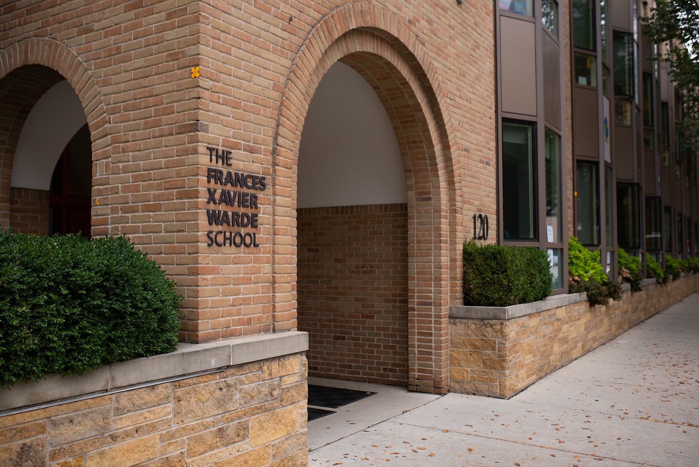
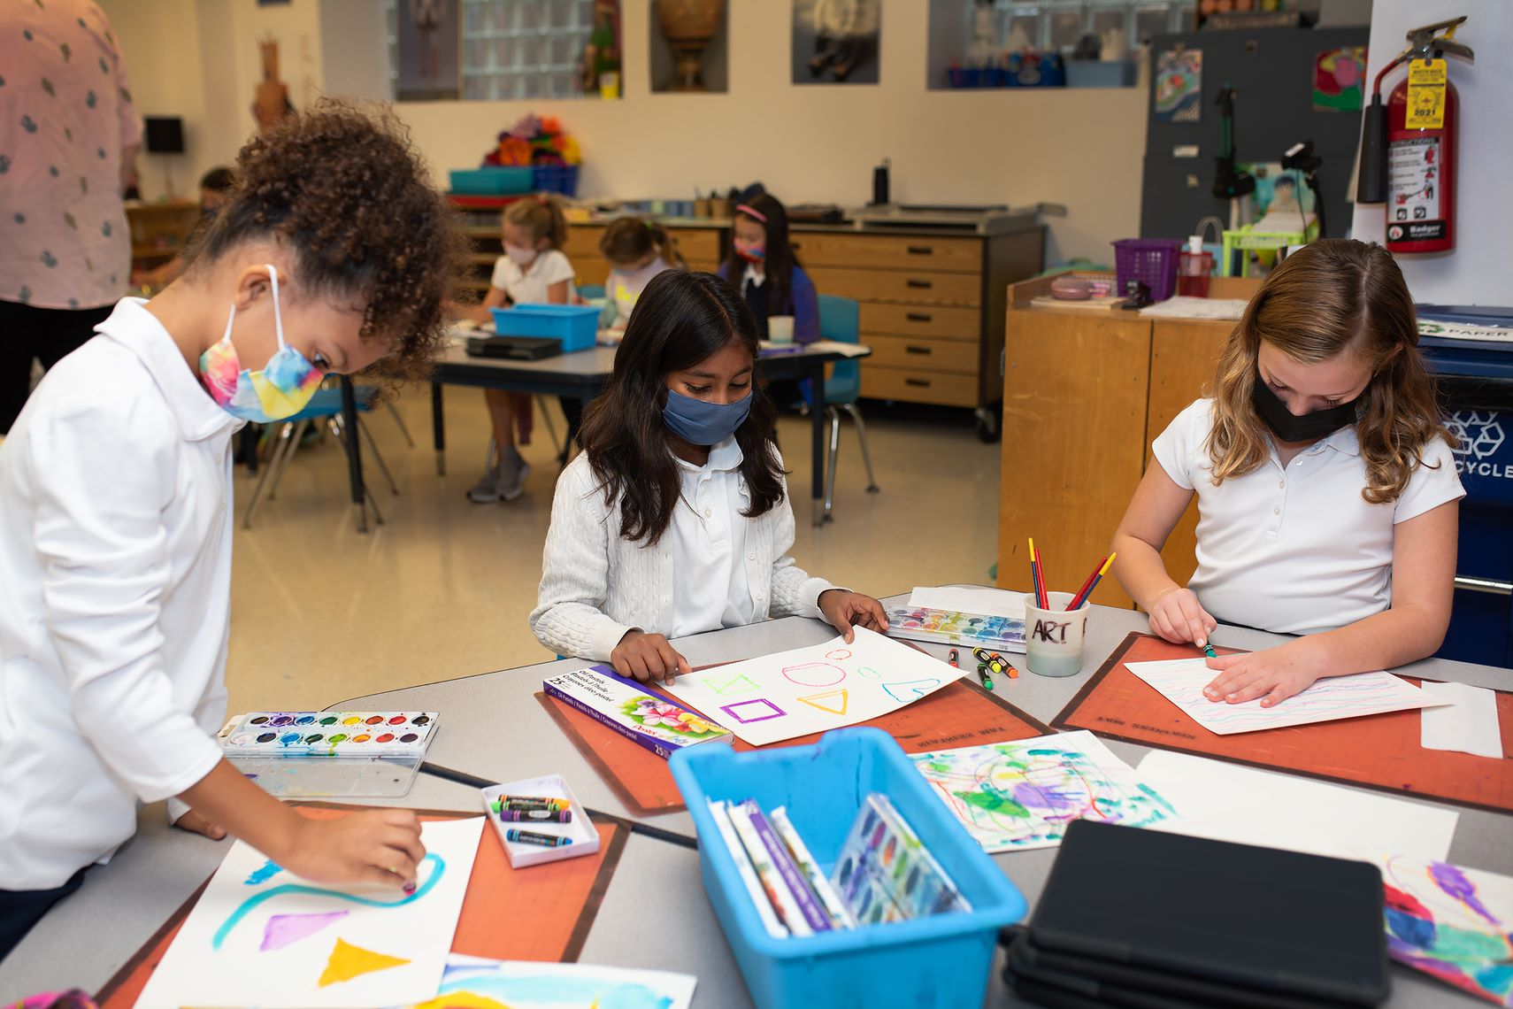
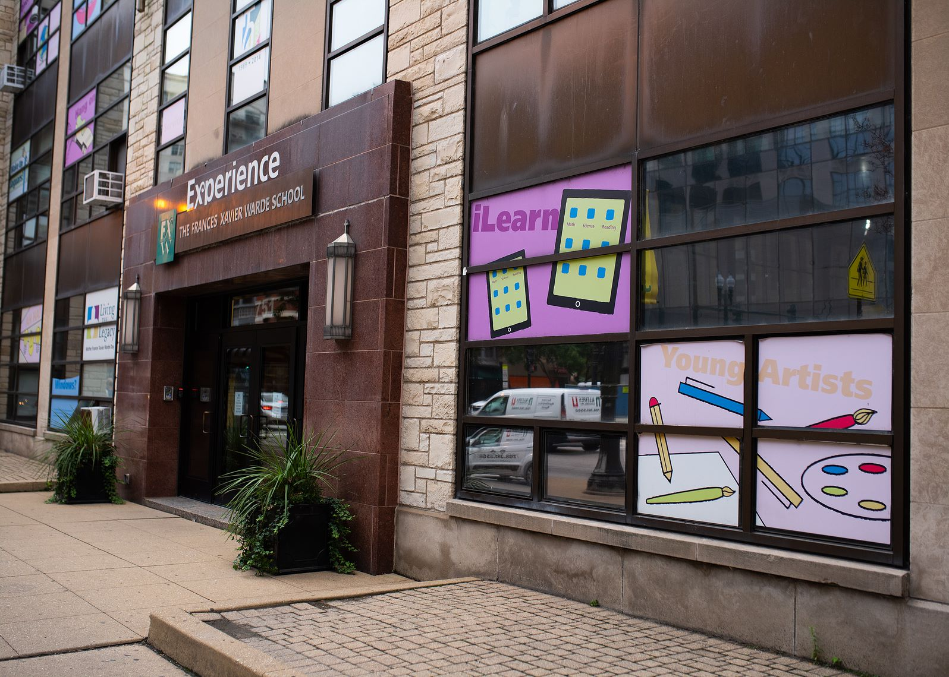
FXW Equity and Justice Forum Town Hall February 15, 2022

Slide 2
Agenda
Prayer/Welcome
Objective of FXW’s Equity and Justice Forum
Updates from Committees
Q & A

Slide 3
Equity and Justice Forum: Objective
The Equity and Justice Forum (EJF) is charged with providing a space and place for listening, dialogue, and greater understanding about race and racism in our country, especially ideas for dealing with current challenges and planning for a better future; and serves as a catalyst for bridging differences regarding race in America, promoting reconciliation, and encouraging fresh perspectives.

Slide 4
Equity and Justice Forum: Objective
As we educate our students on issues of social injustices and inequities, we must recommit ourselves to promoting a society where all have the possibility of life, liberty, and justice. Build it Better describes our commitment to a spirit of continuous improvement.
We use this working body to review our programming, practices, and operations as well as our language, communications, and intentions as we plan for each school year.

Slide 5
Equity and Justice Forum: Outcomes
The Frances Xavier Warde seeks to be the model of a diverse and inclusive school community, the paradigm for Catholic education in Chicago, and the standard for faith-based independent school education.
We realize this vision through proactive and intentional efforts to identify and implement best practices, adapting to the ever-changing circumstances in education, and by adopting a spirit of continuous improvement – all for the benefit of our lifelong learners.

Slide 6
EJF: Committee Leadership
Recruit and Retain a Diverse Workforce
Quamika Pickens-Harris, Director of Human Resources
Diversity, Equity, and Justice Training for Faculty and Staff
Sarah Vaughn, Director of Innovation
Cultural Competency in Curriculum
Conor Luck, FXW Teacher
Bernard Little, FXW Parent and Educator
Admissions: Recruit and Retain a Diverse Student Body
Eboni Dixon, Director of Diversity, Equity and Inclusion & FXW Parent
Community (Students, Parents, Faculty and Staff)
Kendall Mallette, FXW Parent and Educator
Beth Napleton, FXW Parent and Educator

Slide 7
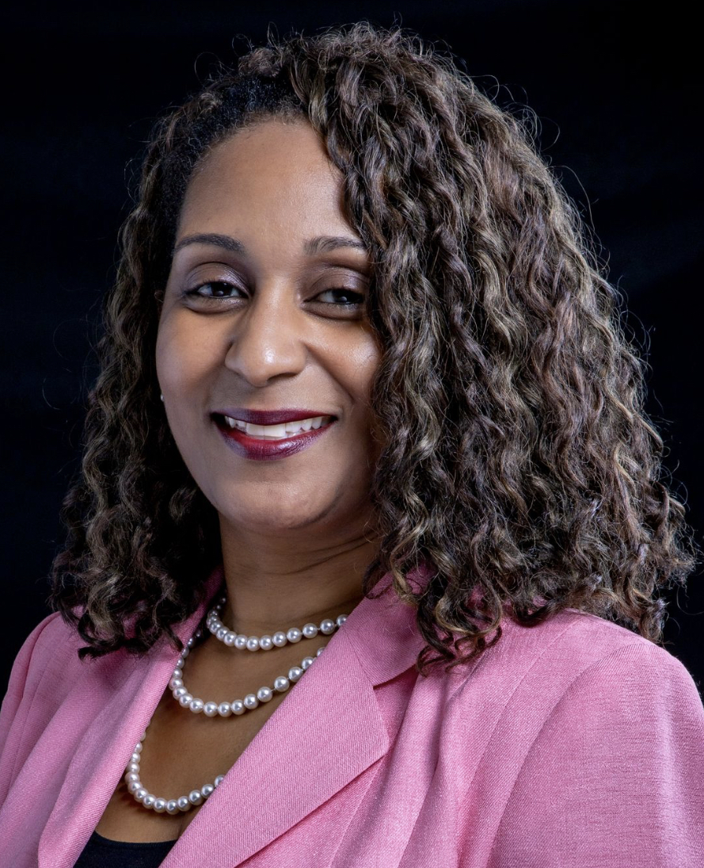
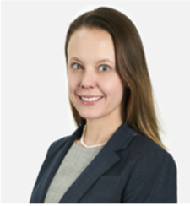
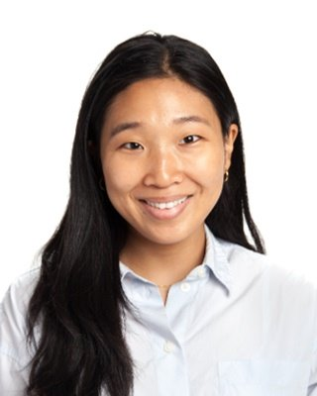
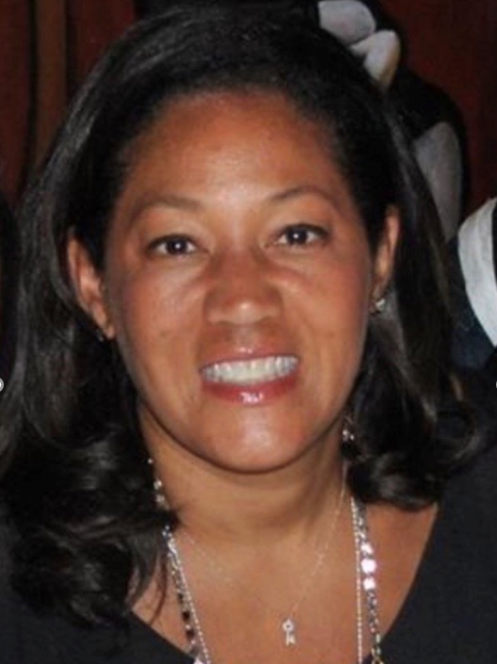
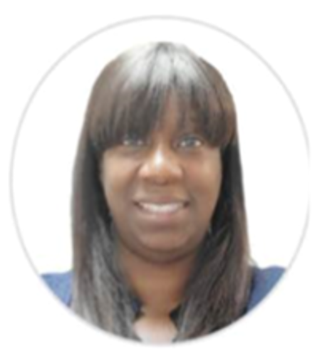
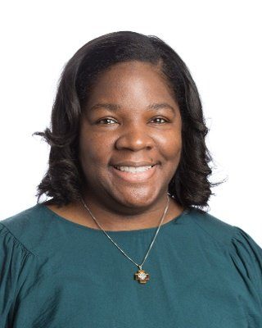
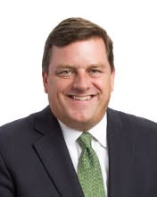
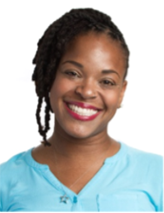
Recruit and Retain a Diverse Workforce
Kristian May Stewart
Mindy Medley Kedvesh
Quamika Pickens-Harris
Hannah Kim
Susan Thomas
Eboni Dixon
Michael Kennedy
Tiara Damper

Slide 8
Recruit and Retain a Diverse Workforce
Quamika Pickens-Harris, Director of Human Resources
Committee Objective: With the combined forces of our HR Director, the Director of Diversity, Equity and Inclusion, and the Leadership Team, our goal is to lend ideas and people power to new strategic planning that is specifically focused on attracting and retaining faculty from underrepresented groups.
Students and Alumni of Color need to see themselves in the leadership of the School and well represented within the faculty. Representation matters, as does the creativity, knowledge, and intelligence that comes from working in more diverse teams. One consequence of the low representation of BIPOC faculty and administrators is the work it adds to those who are underrepresented. Under the leadership of FXW’s Human Resources Director Quamika Pickens-Harris, this committee will ramp up FXW’s efforts to identify, recruit, hire and retain outstanding BIPOC educators and positions of leadership.

Slide 9
Recruit and Retain a Diverse Workforce
2020 – 2021 Accomplishments
Creation of recruiting manual to address the following areas:
- Hiring Policies
- Hiring Processes
- New and Current Employee Onboarding and Training
- Networking Databases
- Marketing and Branding revisions

Slide 10
Recruit and Retain a Diverse Workforce
2021 – 2022 Plans
The committee members have divided into sub-committees to work on the following:
Recruitment Manual: Revising and adding to the recruitment manual. It was identified that a retention plan piece needs to be developed and incorporated.
Creation of new surveys
- 7-day feedback for new employees
- 90-day new employees check-in
- Candidate feedback about the application and interview process
Maintaining and establishing relationships with HBCU’s, local universities, scholarship organizations, and community organizations to have multiple and diverse pipelines for recruitment.
Revising our current marketing, branding, and promotional materials for job fairs. Focusing on how we are presenting FXW to interested parties.

Slide 11
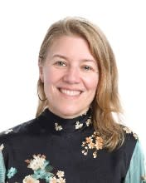
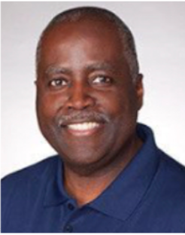
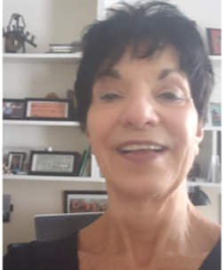
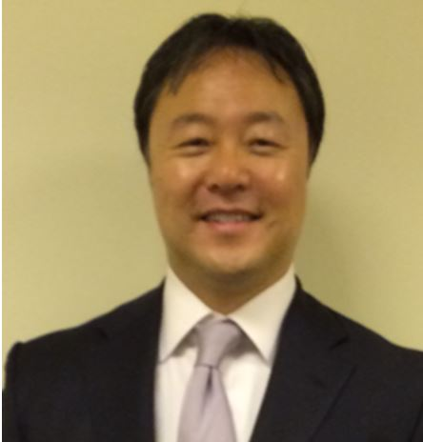
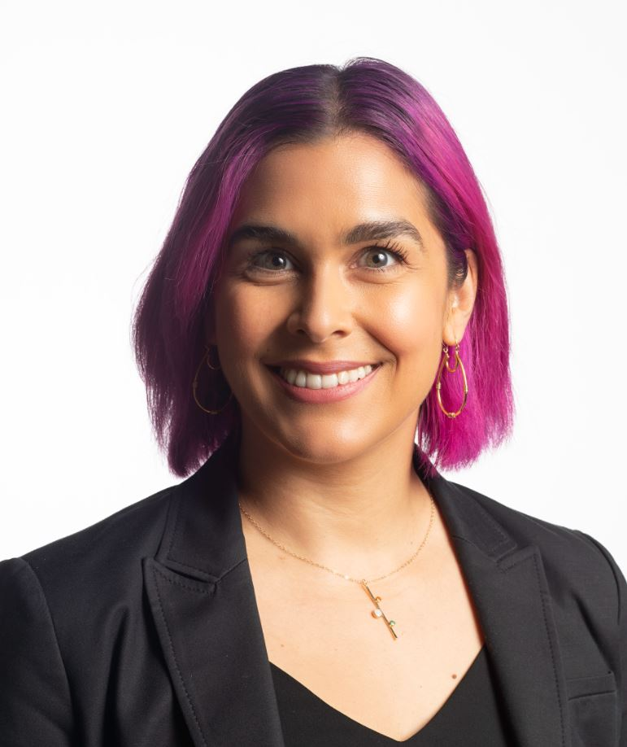
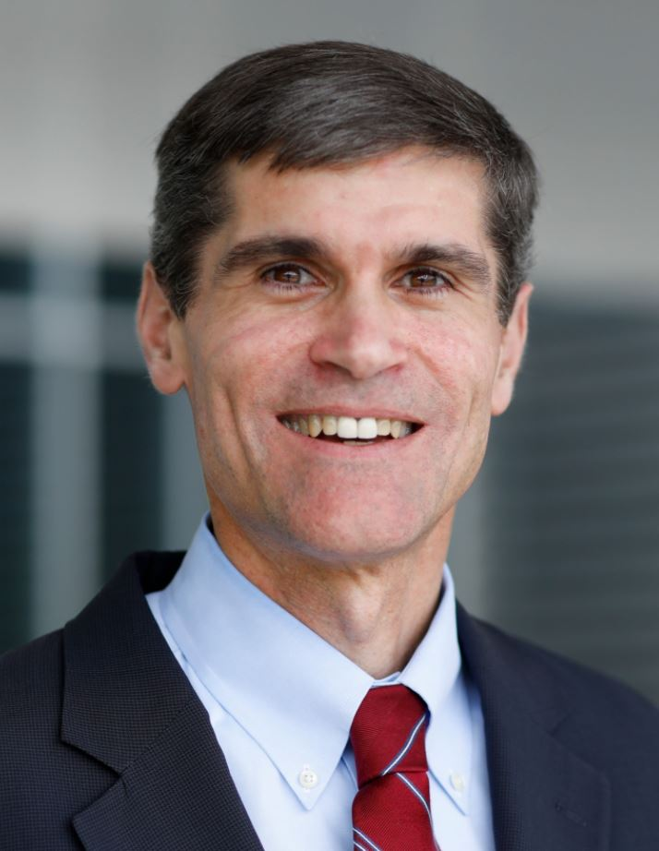
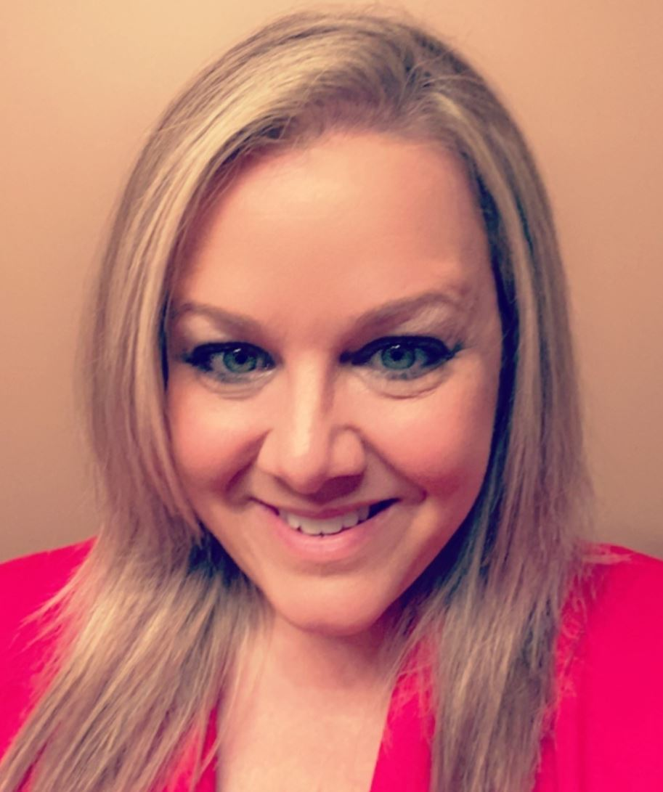
Diversity, Equity and Justice Training for Faculty and Staff
Sarah Vaughn
Howard Greer
Rose Ann Anschuetz
John Kim
Stephanie Hernandez
Not pictured:
Megan Lehrman
Eboni Dixon
Greg Mooney
Valarie Merrill-Cooke

Slide 12
Diversity, Equity and Justice Training for Faculty and Staff
Sarah Vaughn, Director of Innovation
Committee Objective: In addition to SEED and ongoing professional development training with experts in the DEI field, discuss inclusive cultural competency and anti-racist training for faculty and staff.
Faculty and Staff Leadership: Determine best approach for proactively engaging with constituents to ensure students feel safe and supported.
Anti-bias training will continue to be required at all levels, from the board of trustees and senior administration to each and every faculty member and coach who comes into contact with our student body.
This committee will examine the current systems already in place, and further our expectations that every faculty and staff member will participate in professional development with specific attention to race and racism.

Slide 13
Diversity, Equity and Justice Training for Faculty and Staff
2020 – 2021 Accomplishments
Partnership with Karima Wilson of Forged Ed
- Consultation and evaluation of current DEI practices
- Created professional development centered around inclusive practices
- Training on having conversations on race/racism
- Developed metrics to measure effective trainings to improve interactions with all community members

Slide 14
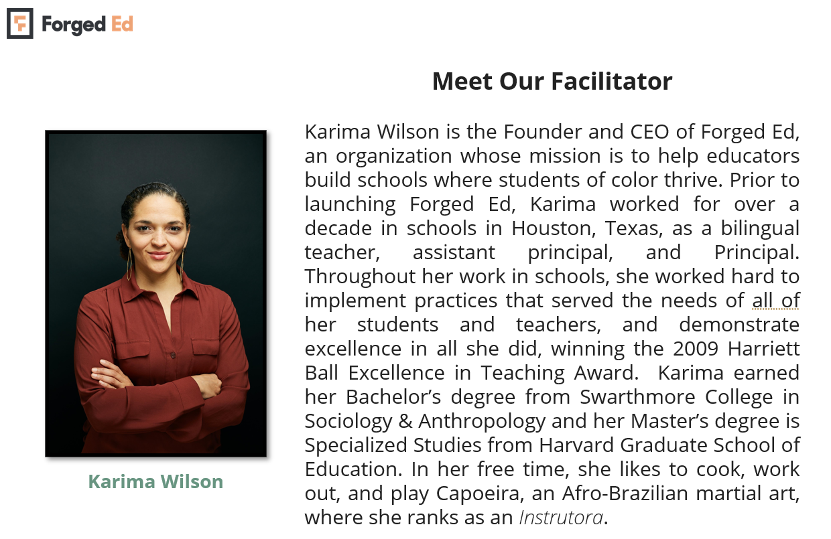

Slide 15
Framework for Faculty & Staff Professional Development 2022

Slide 16
Diversity, Equity and Justice Training for Faculty and Staff
2020 – 2021 Accomplishments
Partnership with Karima Wilson of Forged Ed
- Consultation and evaluation of current DEI practices
- Created professional development centered around inclusive practices
- Training on having conversations on race/racism
- Developed metrics to measure effective trainings to improve interactions with all community members

Slide 17
Diversity, Equity and Justice Training for Faculty and Staff
2021 – 2022 Plans
This year the committee is continuing its partnership with Karima Wilson of Forged Ed.
- Faculty and Staff meet monthly in learning pods to continue development between workshops
- Faculty and staff are participating in workshops and learning pods focusing on having challenging conversations. After workshops, feedback is collected. From our latest workshop:
- 91% of faculty and staff say they find the workshops highly effective
- 87% say they find the content relevant and challenging
- Developing an online resource hub where all faculty and staff will have access to on- demand resources.
- We continue to have cohorts of SEED seminars during the school year and the summer.

Slide 18
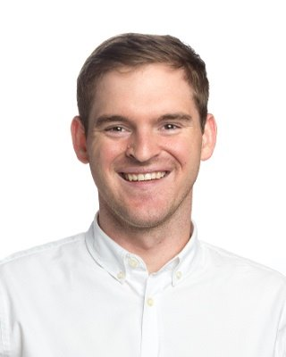
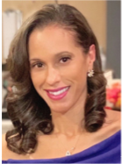
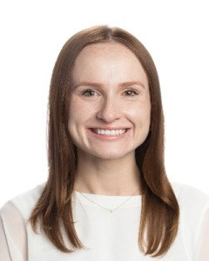
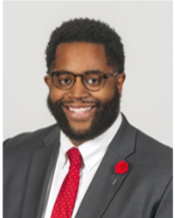
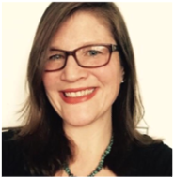
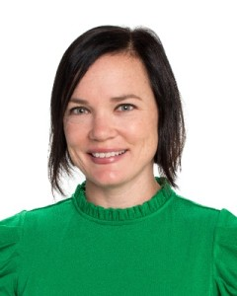
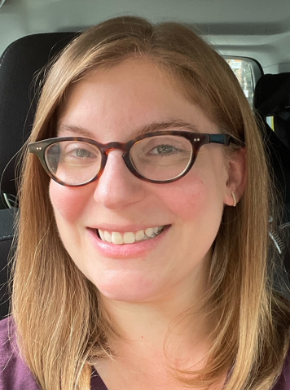
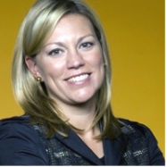
Cultural Competency in Curriculum
Conor Luck
Stacy Frazier
Kristen Hockney
Bernard Little
Emma Coate
Not pictured:
Shenita Johnson Hardy
Yasmin Dalal
Nora Daley
Eboni Dixon
Erin Horne

Slide 19
Cultural Competency in Curriculum
Conor Luck, FXW Teacher
Bernard Little, FXW Parent & Educator
Committee Objective: Discuss and recommend ways in which to integrate cultural competency more comprehensively into curriculum and pedagogy. Develop strategic initiatives to support diversity and inclusion actionable and measurable steps – What does this look like now, what does More look like?
Black, Indigenous, and People of Color (BIPOC) students, faculty and staff often contend with the exhaustion from daily experiences at FXW and beyond our walls; faced with a painful hypervisibility when asked to speak for an entire race as issues of race and racism arise during instruction and in the planning thereof. This committee will focus on the pedagogical and curricular changes needed to enhance the quality of the overall educational experience for every student by making race, anti-bias and anti-racist educational work more central to teaching.

Slide 20
Cultural Competency in Curriculum
Cultural Competency in Curriculum
Connor Luck, FXW Teacher
Bernard Little, FXW Parent & Educator
2020 – 2021 Accomplishments
English Language Arts content review
- Reviewed all books and materials using the Culturally Responsive Curriculum Scorecard
- Accessed cultural representation of characters, authors, illustrators and messages
- Incorporated more diverse portrayal of different ethnic groups and gender identities

Slide 21
Cultural Competency in Curriculum
Cultural Competency in Curriculum
Connor Luck, FXW Teacher
Bernard Little, FXW Parent & Educator
2021 – 2022 Plans
Social Studies content review
This year the committee is working on the Social Studies curriculum as it is the content area up for a curriculum review. The committee is taking on kick starting this curriculum review, a three-year process, with providing research to make suggestions. The committee members have been divided into sub-committees to tackle the following:
- Reach out to area schools to hear about what they are doing to improve their Social Studies curriculum.
- Research best practices for culturally responsive Social Studies instruction.
- Find ways to support teachers with incorporating social justice standards (adapted from Learning for Justice) and diverse primary resources.
The committee recognizes an opportunity to collaborate with the training committee to provide resources for faculty, so they are prepared to incorporate the suggestions and have support to best inform their instructional practices.

Slide 22
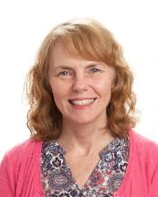
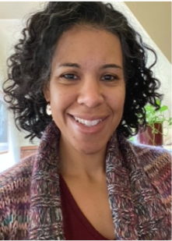
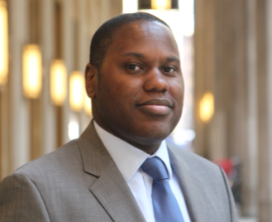
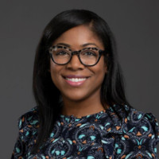
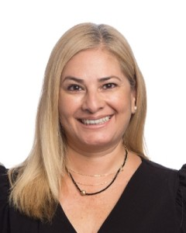
Admissions: Recruitment and Retention of Families of Color
Matthew Kelly
Sue Smeaton
Stacy Robertson
Martin Pankau
Kristin May Stewart
Vinkeia O’Neill
Norma Guzman
Eboni Dixon

Slide 23
Admissions: Recruitment and Retention of Families of Color
Eboni Dixon, Director of Diversity, Equity and Inclusion and FXW Parent
Community Objective: Recommend additional ways in which to provide support to the Admissions Team and develop a sustainable plan for the recruitment and retention of families of color.
The entire community needs to dig deeper to understand and uproot the underlying structural causes of the inequities that underrepresented families continue to experience. There is no other way to make good on our mission.
One of the best ways to accomplish this goal is to continually be intentional about the recruitment and retention of underrepresented families at FXW. This committee will undergird the Admission team in current outreach and retention efforts, as well as brainstorm additional methodologies for increasing the presence of underrepresented families at the School.

Slide 24
Admissions: Recruitment and Retention of Families of Color
2020 – 2021 Accomplishments
Focused on increasing and retaining families of color.
- Created and implemented family exit survey
- Created Leveraging Our Legacy events for recruitment and retention
- Revised recruiting efforts to expand applicant pool

Slide 25
Admissions: Recruitment and Retention of Families of Color
2021 – 2022 Plans
This year the committee is continuing its Leveraging Our Legacy virtual events as they provide interested applicants to hear voices from our community who speak to how an FXW education has prepared them for success beyond graduation. There will be an event coming up at the end of the month for Black History Month. The panel of African American current and alumni students will speak to the charism of faith. The panel will provide their stories of how a diverse community of faith enhanced their educational experience.
- Leveraging Our Legacy events
- future events will focus on a different charism
- events will continue to be virtual
- Creation of a video library of testimonials from families to share their FXW experience
- Recruitment of families of color outreach opportunities are being held with local organizations and expanding our partnerships with scholarship organizations like Horizons for Youth and Daniel Murphy Scholars.

Slide 26
Admissions: Recruitment and Retention of Families of Color

Slide 27
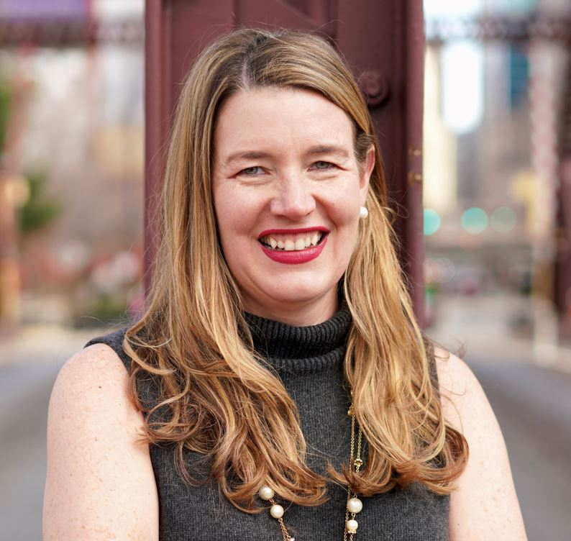
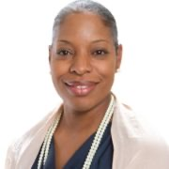
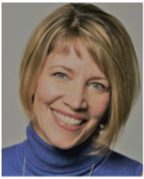
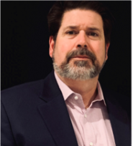
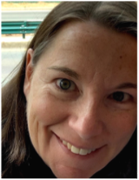
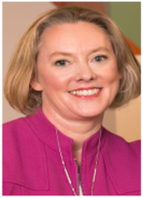
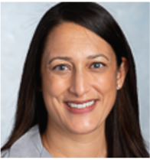
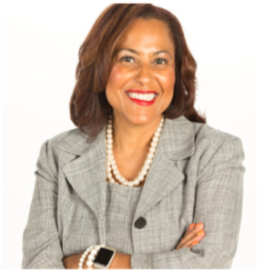
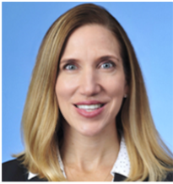
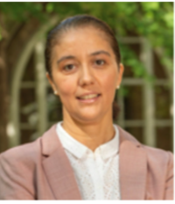
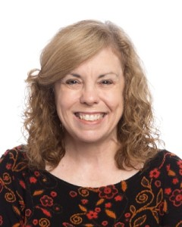
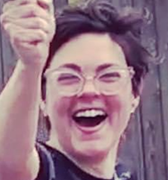
Community
Beth Napleton
Kendall Mallette
Alison Moriarty
Bill Smith
Erin Swanborn
Orla Castanien
Shweta Stuart
John Kim
Naji Garcia
Susan Thomas
Melissa Root
Amparo Grau
Brigid Cashman
Ashley Corotis
Not pictured:
Kerry Kasper
Lara Ventura
Brandi Pope
Qing Xia
Mary Nelligan
Kara Gilardi
Eboni Dixon

Slide 28
Community
Kendall Mallette, FXW Parent & Educator
Beth Napleton, FXW Parent & Educator
Community Objective: Determine measures FXW can take to facilitate common experiences to build a shared understanding that helps the community engage in opportunities that provide a more inclusive culture to ensure everyone feels safe and further fosters a culture of inclusion.
Institutional racism takes a toll on the psychological and physical well-being of students, staff, faculty, parents and alumni of color. Equipped with this knowledge, FXW offers our BIPOC community an apology and recognition that the realities of structural racism in the United States have also shaped our educational institutions, including unintentionally at times in the FXW community.
Against that backdrop, this committee will provide more resources for those who must deal with the impact of racism by incorporating anti-bias training and dialogues as a community-wide practice with the understanding that we all need to learn and gain in self-awareness.

Slide 29
Community
2020 – 2021 Accomplishments
Provided resources that deal with the impact of social injustice through open conversations on race.
- Maggie Daley Speaker Series events
- Community Book Club
- Creation of the Family Values Assignment

Slide 30
Community
2021 – 2022 Plans
This year the committee is focusing on parents. The virtual community discussion events for the book Caste: The Origins of Our Discontents by Isabel Wilkerson were well attended, and many parents expressed their gratitude for FXW providing the space to have these discussions.
- Community Book Club selection for next year
- Spring Family Values Assignment
- Provide families with tools to have discussions about values and race
- School/Home connection with targeted lesson provided in classrooms and continued at home
- Culminating community event

Slide 31
Questions

Slide 32
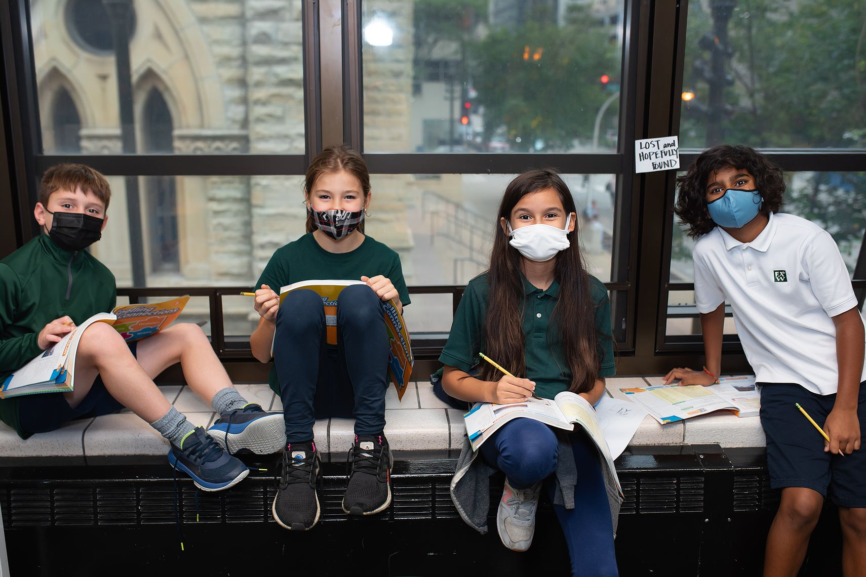
Thank you for attending!

